Slide 1

MACHINE LEARNING IMPLEMENTED SENTIMENT ANALYSIS AND PERSONALITY PREDICTION
A Minor Project, Completed by:
Abhay Nepal – 075BEI003
Dipesh Tripathi – 075BEI013
Gokarna Adhikari – 075BEI014
Kshitiz Dhakal - 075BEI015

Slide 2
Introduction
Threader
web application
uses a machine-learning model to analyze the sentiment of the textual data
predict the personality based on questionnaire

Slide 3

Applications
Support and feedback : Review Analysis
Personality detector
Recommender system
Social media monitoring
Chat bot

Slide 4
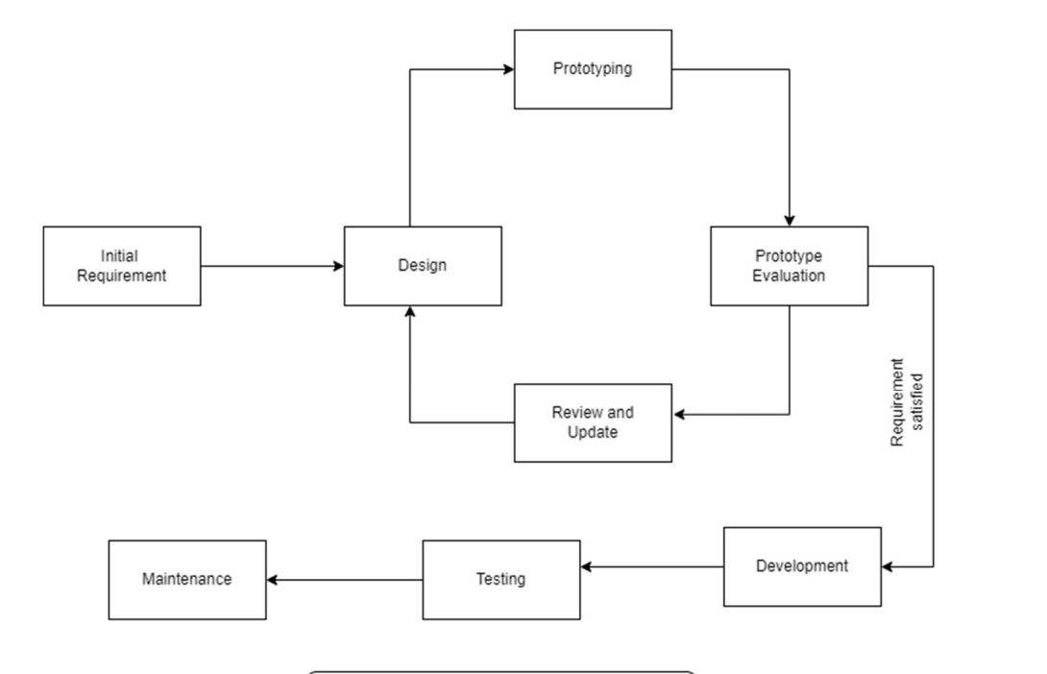
Software Development Process

Slide 5

SDP for each cycle of prototype model

Slide 6
Main Components
Sentiment Analysis
Multinomial Naïve Bayes
Support Vector Machine
Personality Prediction
Random Forest Classifier

Slide 7
Web Application
Frontend using ReactJS
Backend using NodeJS

Slide 8

Development Approach

Slide 9
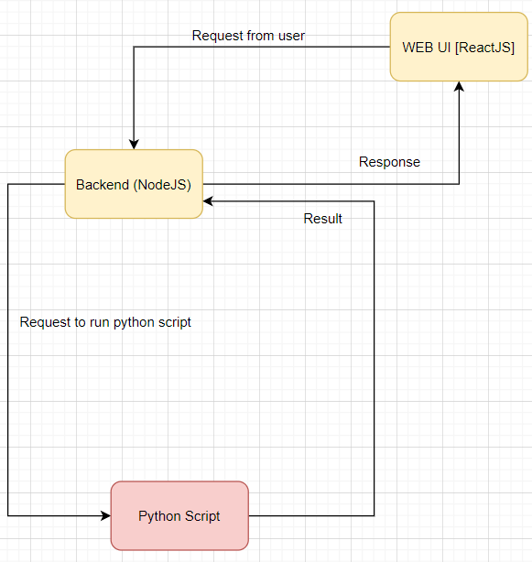
Overall Workflow of project

Slide 10
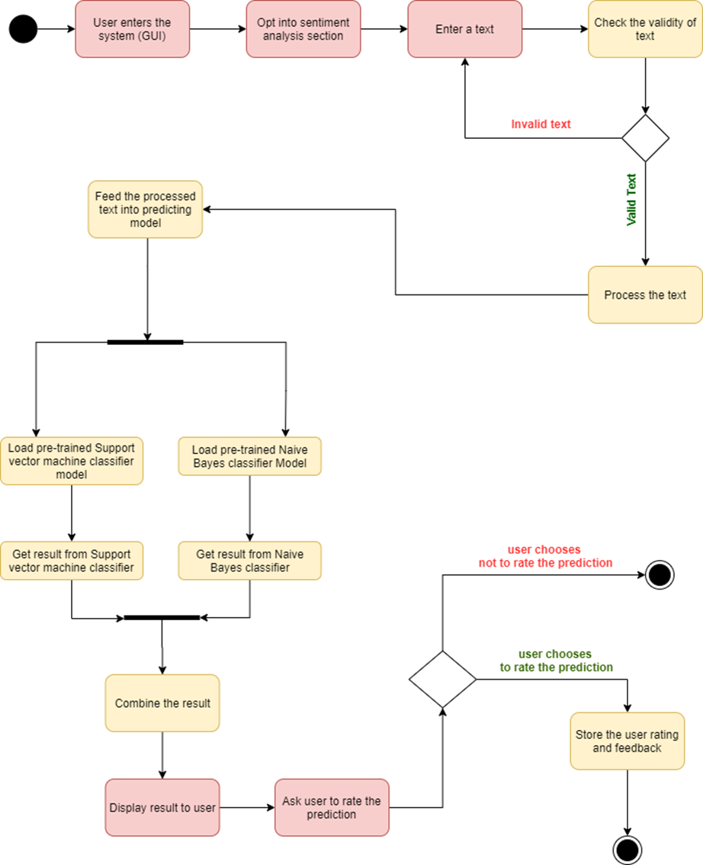
Sentiment Analysis

Slide 11
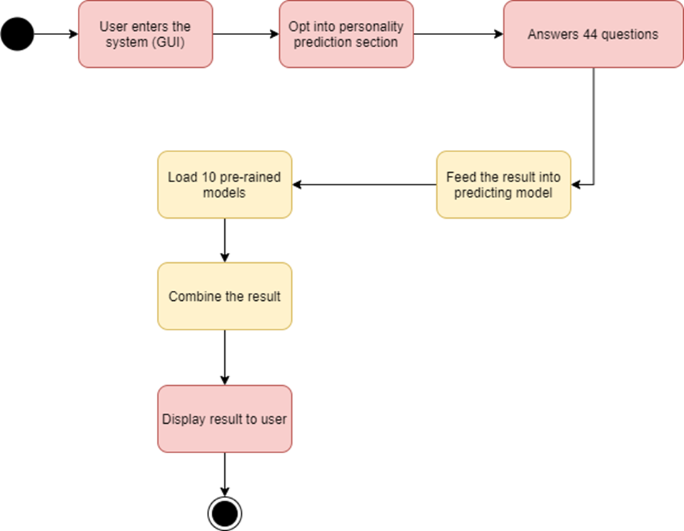
Personality Prediction

Slide 12
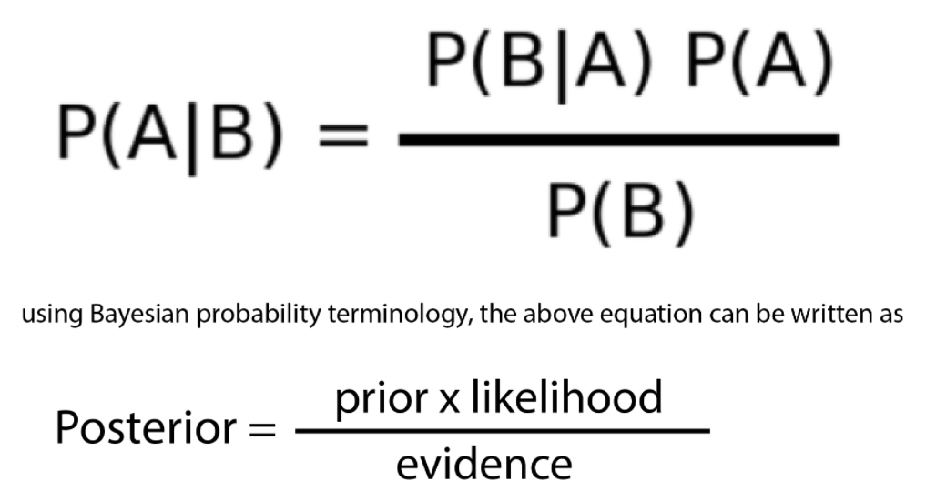
Used Algorithms
Multinomial Naive Baye's :
linear classifiers based on Bayes’ theorem
estimates conditional probability which is the probability that something will happen, given that something else has already occurred

Slide 13
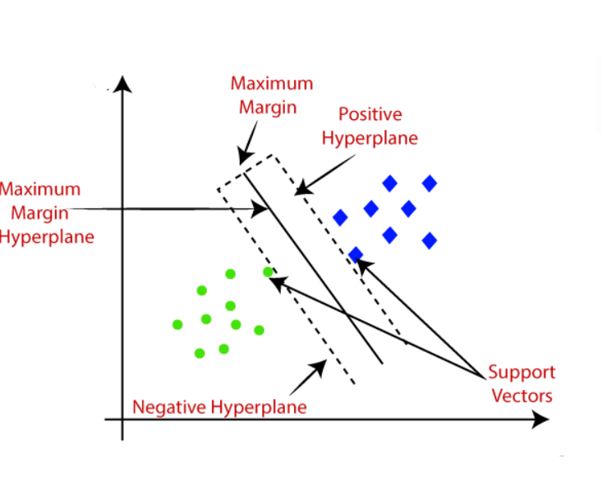
Support Vector Machine(SVM)
one of the most popular Supervised Learning algorithms
used for Classification as well as Regression problems
goal of is to create the best line or decision boundary that can segregate n-dimensional space into classes so that we can easily put the new data point in the correct category in the future
this best decision boundary is called a hyperplane.

Slide 14
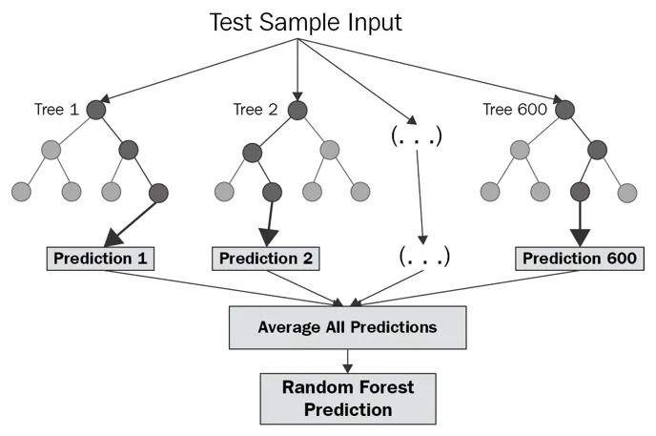
Random Forest Classifier:
a Supervised Machine Learning Algorithm that is used widely in Classification and Regression problems
builds decision trees on different samples and takes their majority vote for classification and average in case of regression

Slide 15

The project at glance

Slide 16
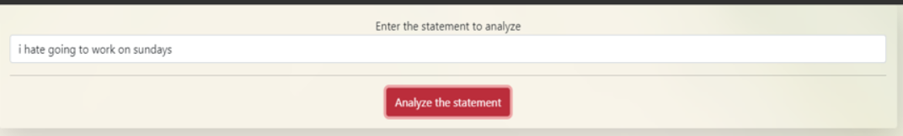
Sentiment Analysis

Slide 17
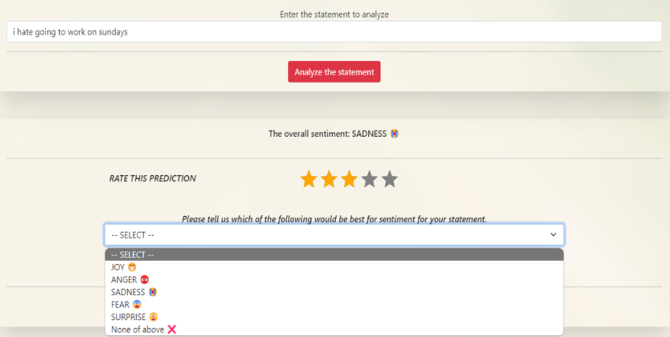

Slide 18
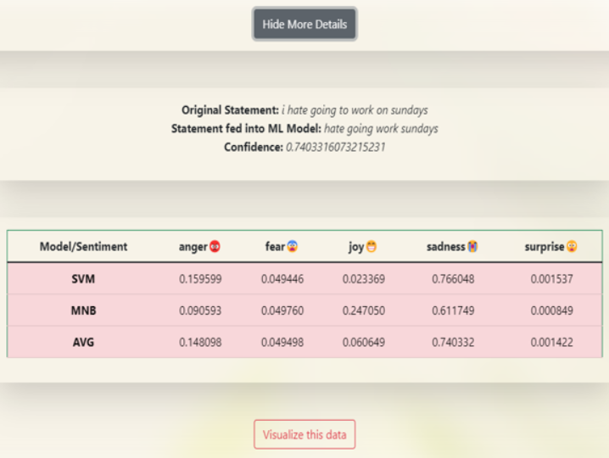

Slide 19
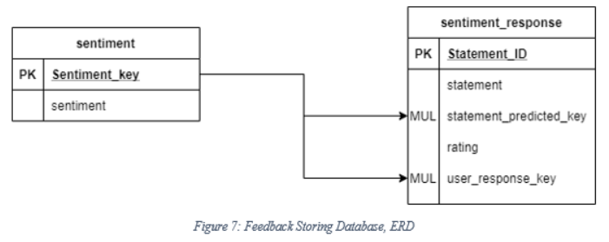
DATABASE

Slide 20
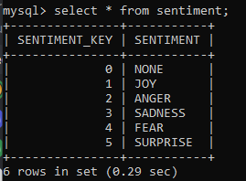
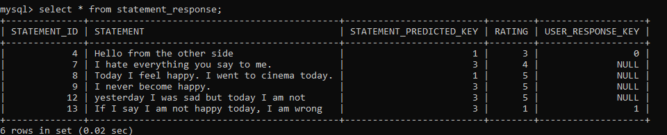
THE TABLE ...

Slide 21
Personality Prediction

Slide 22
10 personality metrices
Extroverted, enthusiastic
Critical, quarrelsome
Dependable, self-disciplined
Anxious, easily upset
Open to new experiences, complex
Reserved, quiet
Sympathetic, warm
Disorganized, careless
Calm, emotionally stable
Conventional, uncreative

Slide 23
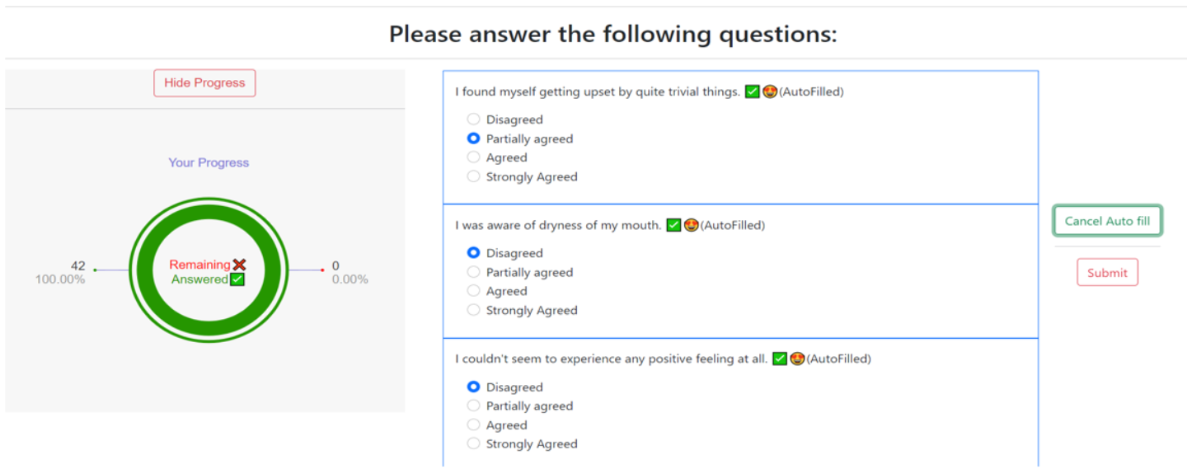
Personality Prediction

Slide 24
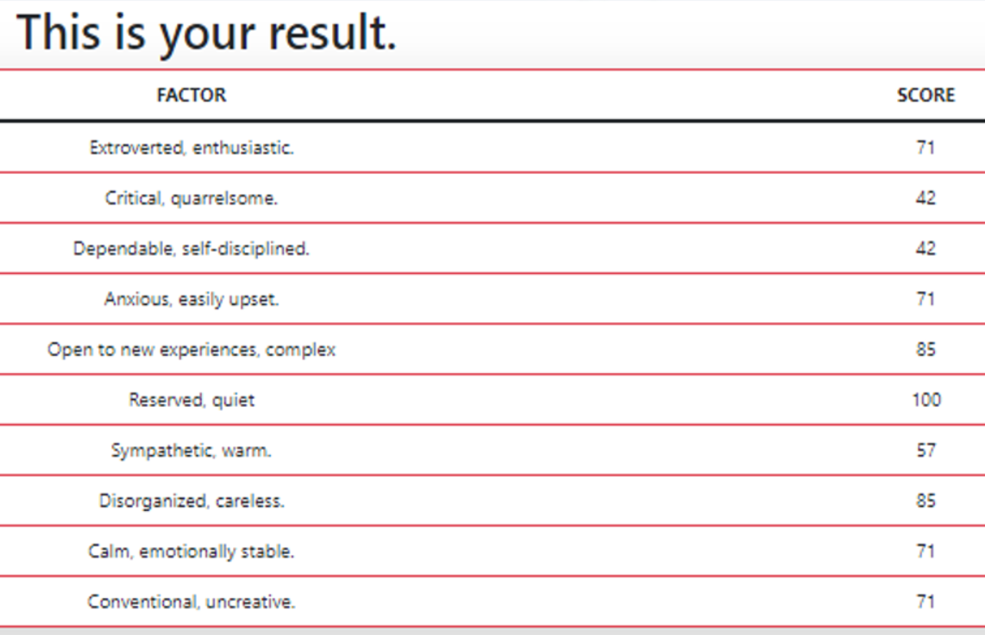
After answering 44 questions ...
Scores are out of 100 ...

Slide 25

Results

Slide 26
Scores
Accuracy
Balanced Accuracy
Average of accuracy of individual predictions
Average of sensitivity [TP] and specificity [TN]
Precision
What is the quality of the predicted data?

Slide 27
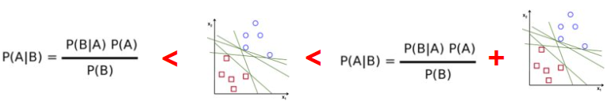
Sentiment Analysis
We combined MNB and SVM rather than choosing one of them.

Slide 28
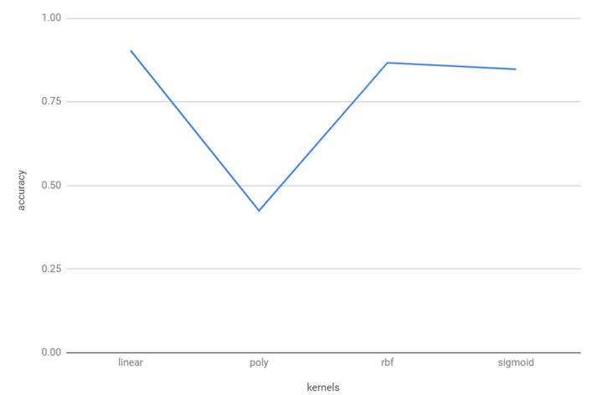
Kernel
A kernel is a function used in SVM for helping to solve problems

Slide 29
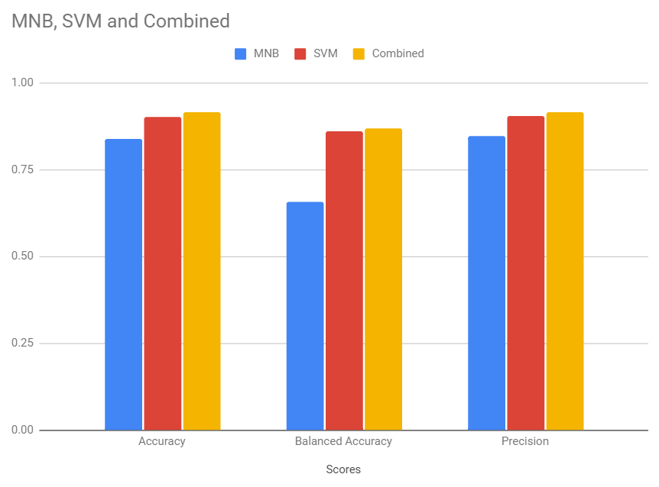
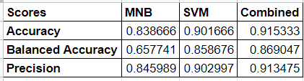
Result of Combination

Slide 30
How we combined the classifiers?
Final Probability = ( M * prob(MNB) + S * prob(SVM) ) / ( M + S )

Slide 31
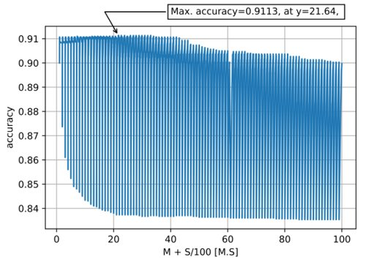
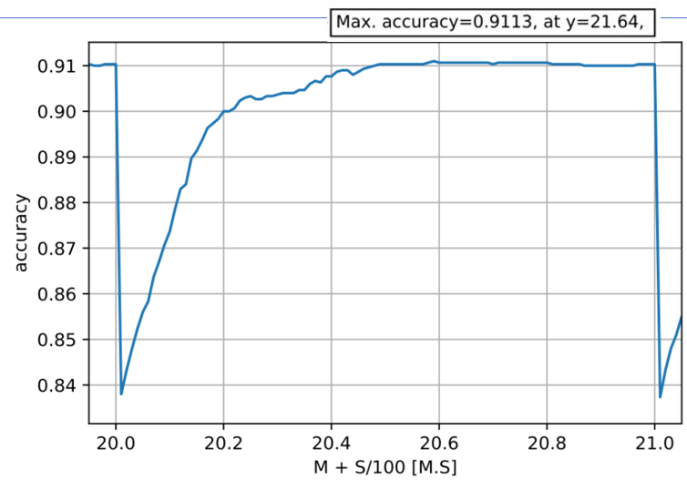
Estimating M and S for maximum accuracy

Slide 32
Personality Prediction
For each personality metrics one RFC model is created

Slide 33
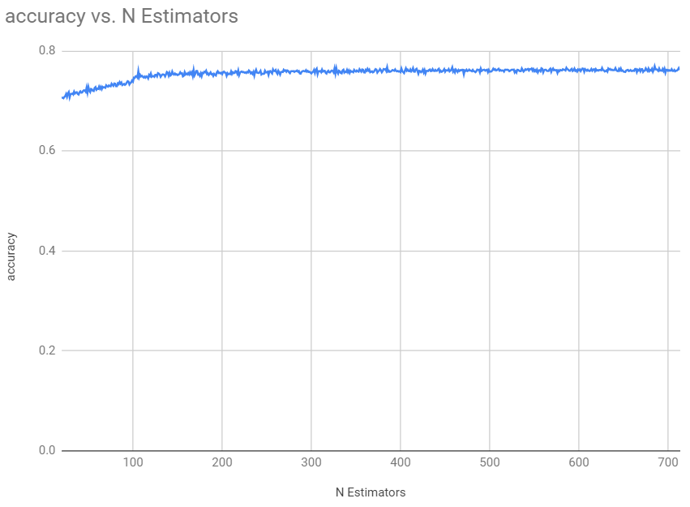
Personality Prediction
Estimating N-estimators, maximum at 385: 0.7673974256

Slide 34
The data for personality prediction
The data was collected with an online version of the Depression Anxiety Stress Scales (DASS)
The survey was open to anyone, and people were motivated to take it to get personalized results.
The dataset comes from those who agreed to complete the research survey and answered yes to the question "Have you given accurate answers, and may they be used for research?" at the end.

Slide 35
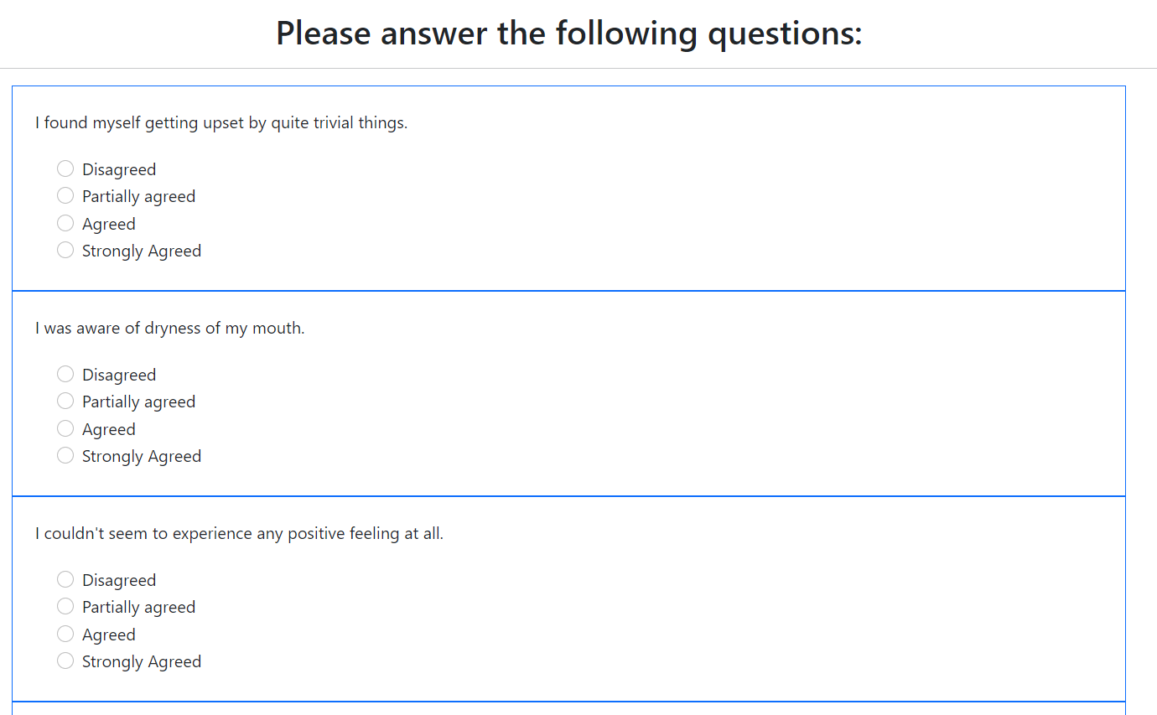

Slide 36
Demonstration

